Slide 1
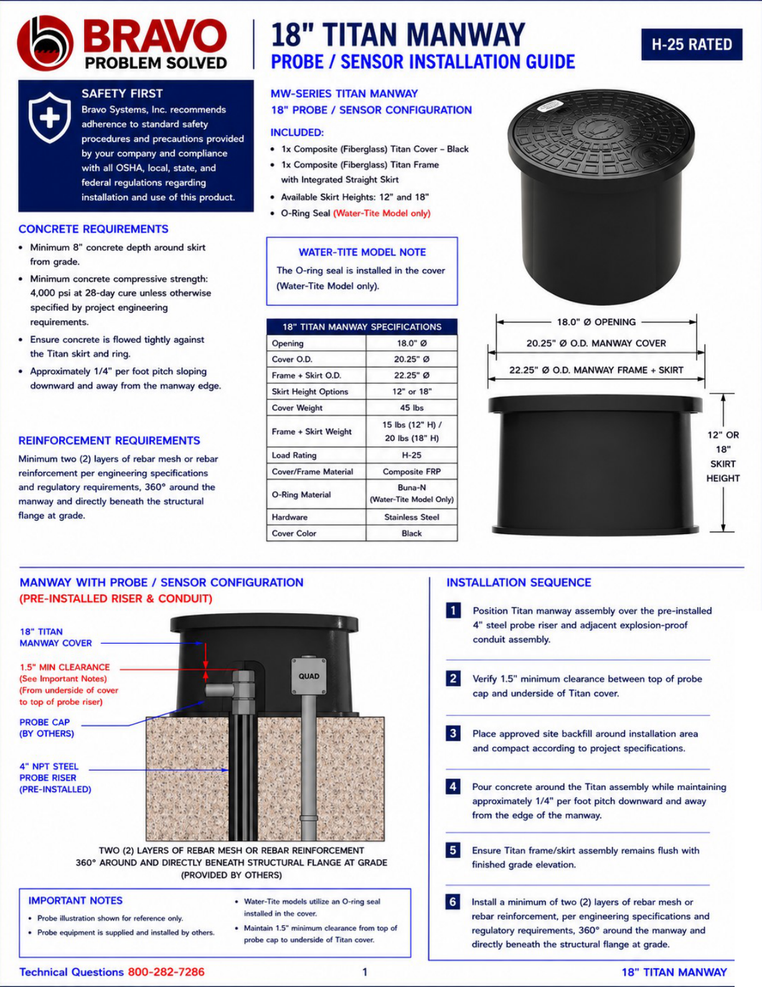
Position Titan manway over the probe/ sensor riser.
Verify 1.5” of clearance under the Titan lid to top of riser or electrical junction box.
Place approved backfill around the Titan base and set pre-concrete level.
Install two layers of rebar or mesh around the Titan and make sure it goes up to the Titan skirt.
Ensure the Titan frame remains flush with finished grade.
Pour Concrete around the Titan and make sure to pitch it ¼” per foot away from the Titan for proper drainage of surface water.

Slide 2
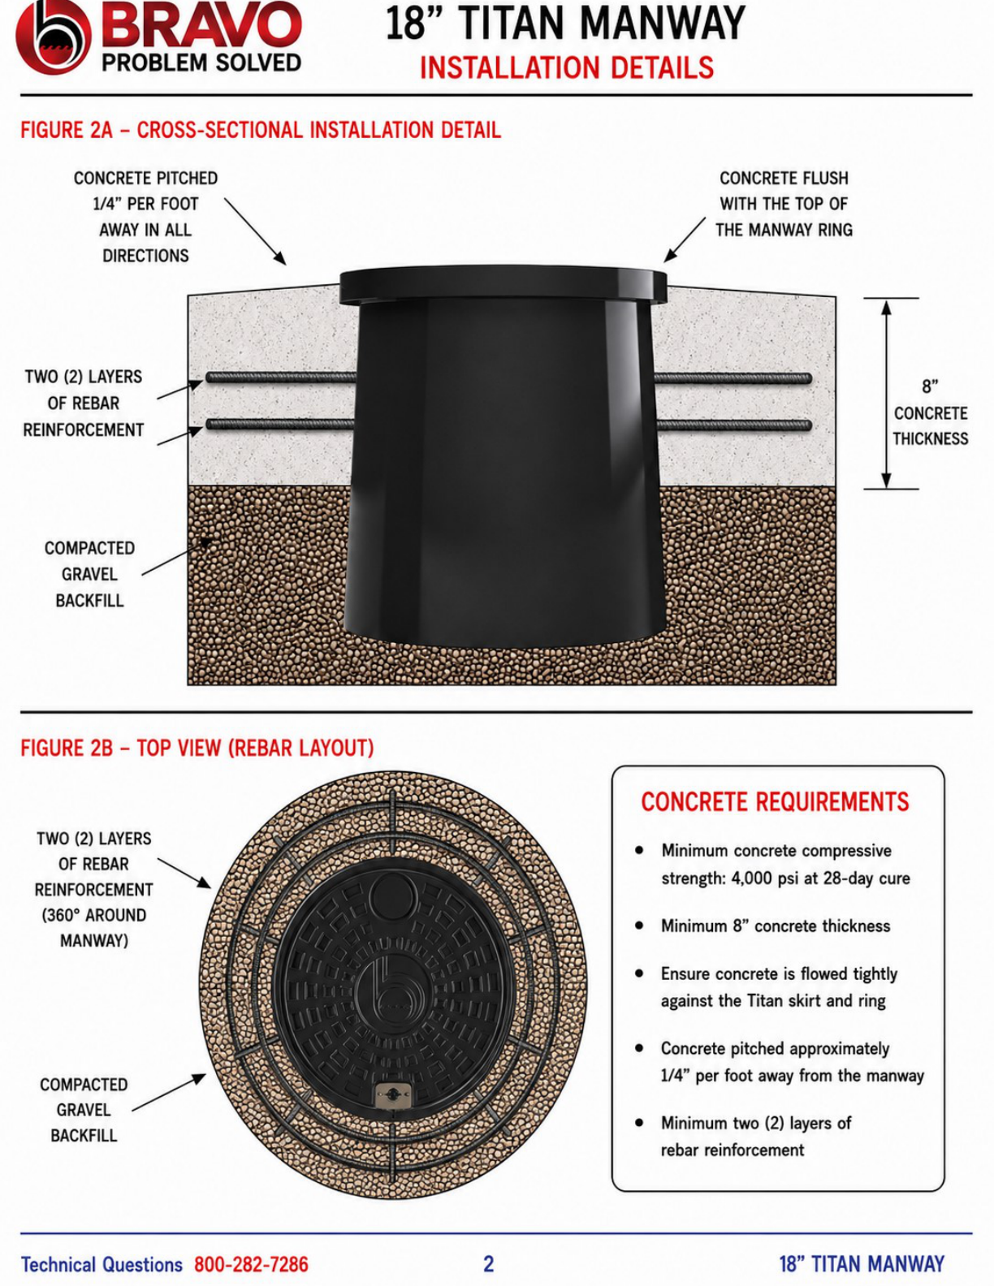

Slide 3
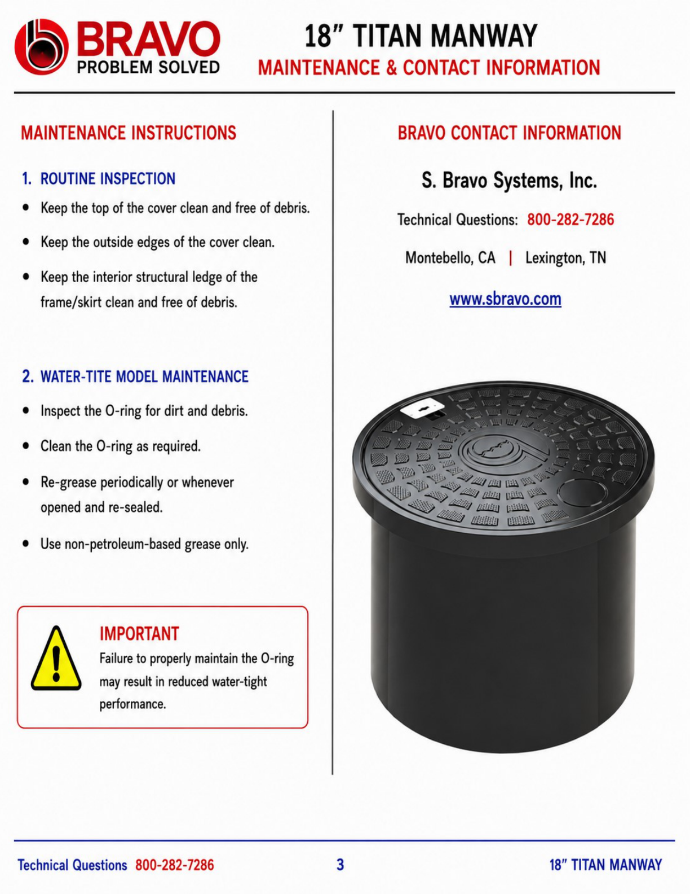
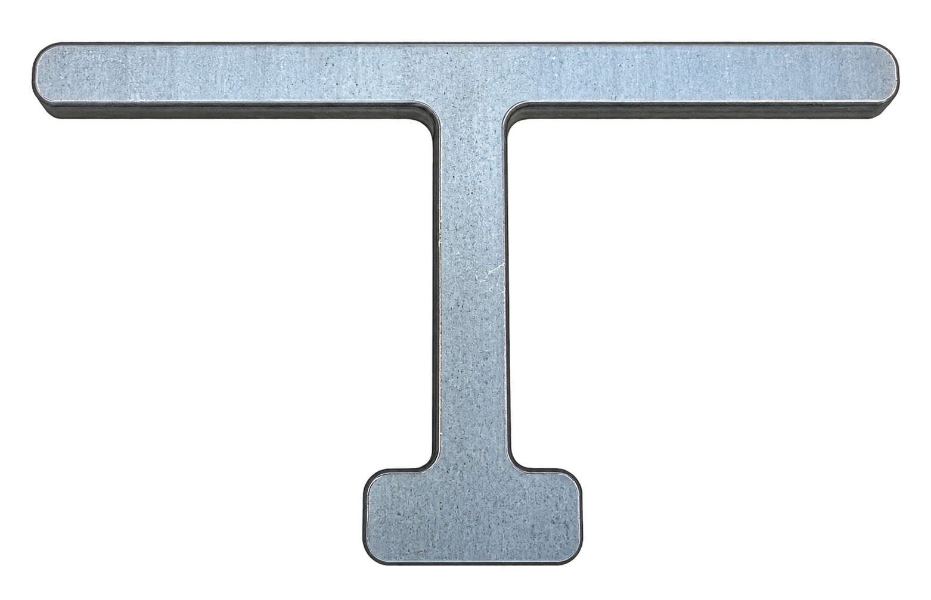
Part# T-M1WT18, Lifting tool for 18” Manway.
Cover will lift off with 50 to 65# lifting force and 23 to 32# pounds to close.
Covers/ring comes pregreased with silicone grease
Extra silicone grease packet comes attached to inside skirt of Manway.
Ring and O-ring seal should be cleaned and regreased after each opening.
Additional silicone grease can be bought in 1-ounce jars, # or-grease
Additional silicone grease can be bought in 1-ounce jars, # or-grease
3. Lifting Tool
Part# T-M1WT18
Cover will lift off with 50 to 65# lifting force and 23 to 32# pounds to close.

